Slide 1
Spring Cloud
API Gateway
Zuul API Gateway
instead of

Slide 2
Spring Cloud
API Gateway
Zuul API Gateway
instead of

Slide 3
Spring Cloud
API Gateway
Introduction

Slide 4
Client App
Spring Cloud API Gateway
Load Balancer
Logging
Validation
Routing
Eureka
Search
Users
Users
Users
Account Management
Account Management

Slide 5
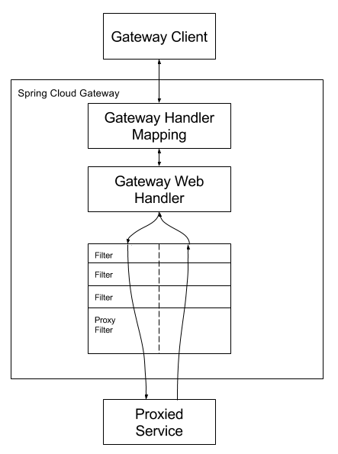
1.
2.
3.

Slide 6
Client App
Spring Cloud API Gateway
Validate JWT Filter
Eureka
Users
Users
Users

Slide 7
Pre-filters
Post-filters

Slide 8
Pre-filters
Post-filters

Slide 9
1.
1.
Pre-filters
2.
2.
Post-filters
3.
3.
n
n

